Slide 1
Web Application for Restaurant Roll Call Staff Management

Slide 2
Team Members
Project Advisor
Project Sponsor
Brendan Maska - Leader
Quincy Adamski
Adarsh Bains
Carmen Cruz
Shine Zaw
Dr. Chen
Tricia Jakacky
Shift Solutions LLC

Slide 3
Project Purpose

Slide 4
User Stories
As a college student, I want to be able to find work that fits within my schedule
As an older person, I want to find work without overly complicated technology
As a restaurant owner, I want to be able to find people to work staffing gaps
As a manager, I want to save my favorite workers, so I can invite them for future openings
As a worker, I want to receive notifications about open shifts near me
As a restaurant owner, I want to find workers that have a high rating and are dependable
As a worker, I want to see the pay and time of the shift before applying
As a user, I want to have an interface that is simple and quick to use
As a restaurant owner, I want an interface that is simple and intuitive
As a user, I want to be sure that this app keeps my data secure

Slide 5
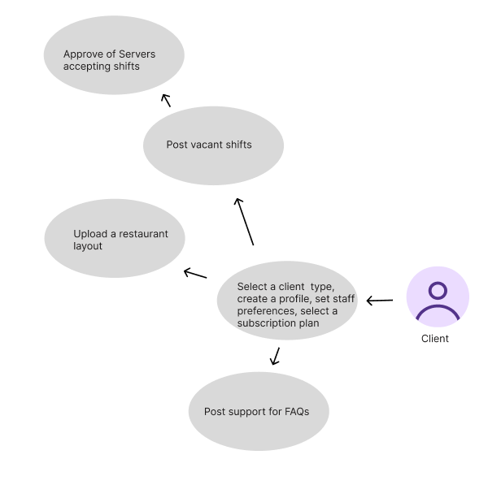
Client Use Case Diagram

Slide 6
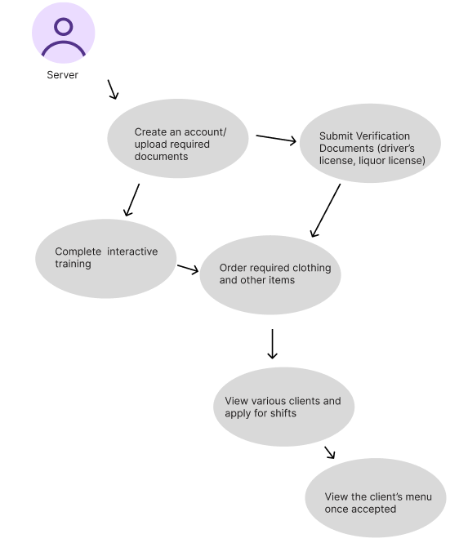
Server Use Case Diagram

Slide 7
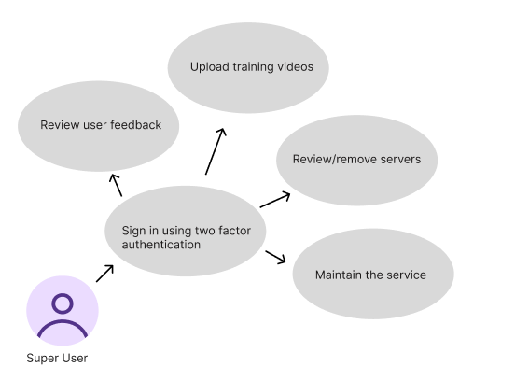
Super User Use Case Diagram

Slide 8
Main Requirements by Role
As the super user, I can
Sign up / log in with 2FA so that my access to the admin portal is secure.
Review user feedback so that I can identify issues and improve the platform.
Review or remove servers/client accounts so that only legitimate and active clients remain on the system.
Maintain the service so that the platform remains reliable and trusted.

Slide 9
Main Requirements by Role
As the client, I can
Sign up / log in with 2FA so my account is secure and only I can access the client portal.
Complete my profile (business info, .etc), select a subscription plan, and set staff preferences so the portal reflects my restaurant’s specific needs.
Upload layouts / training videos so temporary staff can onboard faster.
Post shifts with details (role, time, pay, requirements) so I can fill vacancies.
Review applicants and confirm one so my shift is covered.

Slide 10
Main Requirements by Role
As the server, I can
Sign up / log in with 2FA so my account is secure and only I can access the server platform.
Create a profile where I can submit my verification documents, complete interactive training, get a tier rating, and complete compliance checks so employers are able to evaluate me.
Browse and apply for shifts so I can find work.
See confirmed shifts so I know I’m scheduled.

Slide 11
Role-Specific Requirements
Super User
Maintain the service to ensure reliability and trust
Review user feedback to improve the platform
Remove or review accounts to keep the system legitimate and active

Slide 12
Role-Specific Requirements
Client (Restaurant Owner/ Manager)
Manage subscription plans and staff preferences
Upload restaurant layouts and training materials for faster onboarding

Slide 13
Role-Specific Requirements
Staff
Complete verification documents, interactive training, and compliance checks
Earn tier ratings to reflect performance and reliability
View/confirmation of scheduled shifts

Slide 14
Functional Requirements
The platform let restaurants post open shifts with details like role, pay, and timing.
Waiters can browse, filter, and apply for shifts.
Both sides manage profiles, messaging, shift confirmations, and reviews.
Payments, cancellations, and basic dispute resolution are also supported.

Slide 15
Technical Requirements
The stack includes Reactjs, TypeScript, Tailwind, Html for the UI, VS code IDE
FastAPI for APIs, Github and
PostgreSQL for structured data storage.
Secure authentication (JWT), role-based permissions, API versioning, input validation, and HTTPS.
Python backend
Redis/ Celery handle notifications and payouts.

Slide 16
Challenges & Risks
Technical Learning Curve - Team is new to React, FastAPI, and PostgreSQL
Integration Issues - Frontend, backend, and database may not connect smoothly
Security & Data Privacy - Handling sign-ups and documents requires secure design
Time Management - Capstone runs alongside other classes

Slide 17
End Goal
Build a functional demo web app with:
  Restaurant portal
  Staff portal
  Basic admin portal
Provide sponsor with an investor-ready demo to showcase the concept
Lay the foundation for future features(payments, background checks, mobile app)

Slide 18
Timeline
Sprint 1 - 5 Weeks (Creating Sign on and Log in Portals + Landing Page)
Sprint 2 - 5 Weeks (TBD)
Sprint 3 - 4 Weeks (TBD)
Meeting with Project Sponsor after every sprint to confirm progress
Consistent communication with sponsor via email to confirm that the project is of quality

Slide 19
Prototype
https://www.figma.com/design/B0JaiRGg4P9umn4KjFWQbz/Untitled?node-id=0-1&t=iwOYsN2jvSKEar4c-1

Slide 20
Q & A

